Slide 1
Cryptographic Hash Functions
Hash Functions

Slide 2
Cryptographic Hash Functions
Maps an arbitrary length input to a fixed-size output.
Was originally proposed to generate input to digital signatures.
Desirable features:
  one-way (preimage and second preimage resistant)
  Find x : H(x) =y (preimage) and find x’ : H(x)=H(x’) (second preimage)
  pseudorandom
  collision resistant ( find x and x’ : H(x) = H(x’)
CS470, A.Selcuk
Hash Functions

Slide 3
Collision Resistance
But why “collision resistance”?
(i.e., not just one-wayness?)
  A chosen p.t. attack: Trudy is Alice’s secretary.
  Generates two opposite messages, each with √N (e.g., 2³² for N = 2⁶⁴) different ways of putting it.
  Repudiation: Alice generates two different messages and signs one of them. Later, she denies her signature and claims she in fact signed the other one.
Birthday Problem (“paradox”): When √N or more are chosen randomly from a domain of N, there is a significant chance of collision.
Hence, output size ≥ 128 bits is desirable.
Hash Functions

Slide 4
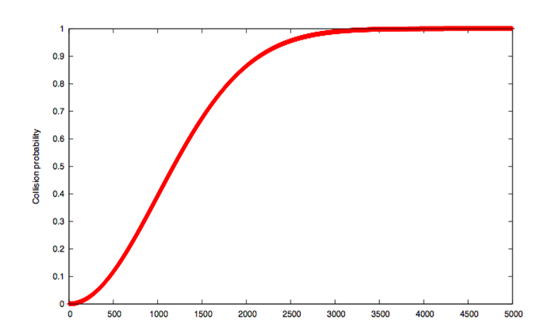
“Birthday Paradox”
E.g. N = 10⁶ :
Hash Functions

Slide 5
Internals of a Hash Function
Merkle-Damgard construction:
A fixed-size “compression function”.
Each iteration mixes an input block with the prev. output.
m =
x₁
x₂
. . .
x_{n}
m
y_{i-1}
compression
fnc.
H(m)
x_{i}
y_{i}
y_{n}
y_{i-1}||x_{i}
Hash Functions

Slide 6
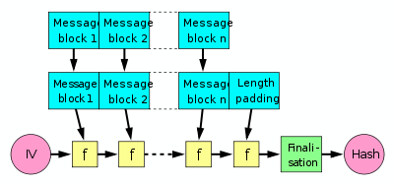
Merkle-Damgard Construction
Input is broken into equal-sized blocks and fed into the compression function.
Length padding: 100…0 || (length of message). (Why?)
Finalization: Optional
Provable security: If f is collusion resistant, the hash function is collusion resistant.
Hash Functions

Slide 7
Hash Fnc. from a Block Cipher
Compression fnc. from block cipher (Rabin):
Split the message into key blocks. (why not pt.?)
Encrypt a constant (e.g. 0) with this seq. of keys.
Ciphertext is the hash output.
Hash Functions

Slide 8
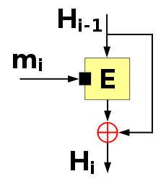
Hash Fnc. from a Block Cipher (cont.)
Davies-Meyer Construction:
H_{i} = H_{i-1} ⊕ E_{mi}(H_{i-1})
Compression function is provably secure (collision resistant) if E is a secure block cipher.
Hash Functions

Slide 9
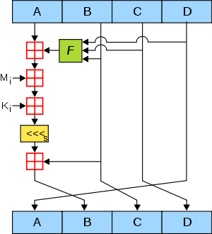
MD5
64 rounds of:
Rivest, 1991
Based on Davies-Meyer const.
Very popular until recently.
  2004: First collision attacks
  2008: Practical collision attack; SSL cert. with same MD5 hash.
  ~2010: Forged Microsoft MD5 certificates used in Flame malware
Preimage resistance: Mostly ok.
Hash Functions

Slide 10
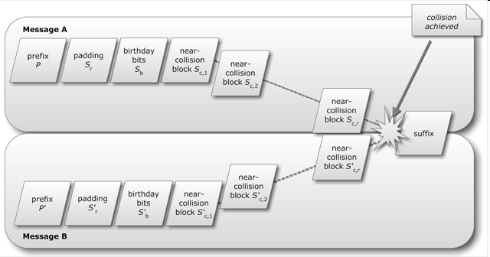
Flame’s MS Windows MD5 Attack
Chosen-prefix coll. attack: Meaningful initial blocks, followed by random blocks to obtain collision.
Hash Functions

Slide 11
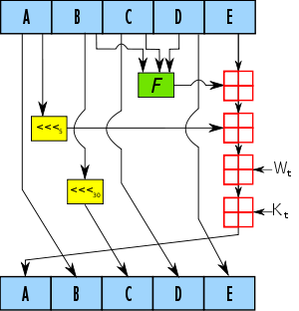
SHA-1
80 rounds of:
Designed by NSA; based on Rivest’s MD4 & MD5 designs
SHA 1993; SHA-1 1995
160-bit output size
2005: Some flaws discovered.
SHA-2: 256- and 512-bit extension; secure
SHA-3: By public competition
Hash Functions

Slide 12
SHA-3
Public competition by NIST, similar to AES:
NIST’s request for proposals (2007)
51 submissions (2008)
14 semi-finalists (2009)
5 finalists (2010)
Winner: Keccak (2012)
  Designed by Bertoni, Daemen, Peeters, Van Assche.
  Based on “sponge construction”, a completely different structure.
Hash Functions

Slide 13
Speed Comparisons
Algorithm | Speed (MiByte/s.)
AES-128 / CTR | 198
MD5 | 335
SHA-1 | 192
SHA-256 | 139
SHA-3 | ~ SHA-256
Crypto++ 5.6 benchmarks, 2.2 GHz AMD Opteron 8354
NIST expects SHA-2 to be used for the foreseeable future.
SHA-3: A companion algorithm with a different structure and properties.
Hash Functions

Slide 14
Things to Do with a Hash Function
Hash long messages for signing
Authentication protocols
Stream ciphers
Block ciphers
MACs
. . .
Hash Functions

Slide 15
Authentication Protocol
Challenge-response authentication instead of a password protocol:
Hash is used instead of block cipher encryption E_{K}(r_{a}), E_{K}(r_{b}), & decryption.
Alice
hello, r_{a}
Bob
H(K || r_{a}), r_{b}
H(K || r_{b})
Hash Functions

Slide 16
Stream Cipher
CFB:
O_{i} = H(K || C_{i-1})
C_{i} = P_{i} ⊕ O_{i}
P_{i} = C_{i} ⊕ O_{i}
OFB:
O_{i} = H(K || O_{i-1})
C_{i} = P_{i} ⊕ O_{i}
P_{i} = C_{i} ⊕ O_{i}
CTR:
C_{i} = P_{i} ⊕ H(K || IV + i)
P_{i} = C_{i} ⊕ H(K || IV + i)
CS470, A.Selcuk
Hash Functions

Slide 17
Block Cipher
Use the hash function as the f in a Feistel structure.
Luby & Rackoff (1988): Three rounds are needed for security.
CS470, A.Selcuk
Hash Functions

Slide 18
MACs from Hash Functions
A natural relative; but how to do it best?
prefix: MAC_{K}(x) = H(K || x)
  not secure; extension attack.
suffix: MAC_{K}(x) = H(x || K)
  mostly ok; problematic if H is not collision resistant.
envelope: MAC_{K}(x) = H(K₁ || x || K₂)
HMAC: MAC_{K}(x) = H(K₂ || H(K₁ || x))
  provably secure; popular in Internet standards.
CS470, A.Selcuk
Hash Functions

Slide 19
VMAC
Proposed by Ted Krovetz in 2006.
Based on a universal hash rather than collision resistant hash. (which is fine for MAC)
Extremely fast (3 GB/sec); adjustable security-speed tradeoff.
VMAC-64 is about 10x faster than HMAC-MD5; has a security proof that Pr(forgery) < 2⁻⁶⁰.
Very suitable for infrastructure (routers) or low-end (RFID, WSN) authentication.
CS470, A.Selcuk
Hash Functions

